Slide 1
Neural Network
Chul Min Yeum
Assistant Professor
Civil and Environmental Engineering
University of Waterloo, Canada
CIVE 497 – CIVE 700: Smart Structure Technology
Last updated: 2020-03-27

Slide 2
Supervised Neural Networks
Inputs
Learn (Input, Output)
updates internal state
Outputs
updates internal state
Predict from (inputs)
Inputs
Outputs

Slide 3
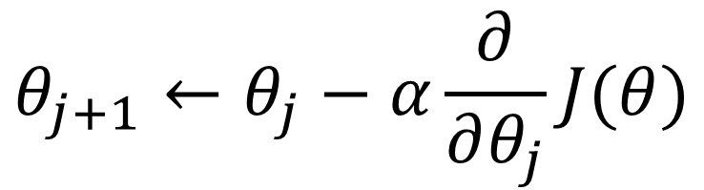
Gradient Descent
Gradient descent is an iterative machine learning optimization algorithm to reduce the cost function so that we have models that makes accurate predictions.
Cost function(J) or loss function measures the difference between the actual output and predicted output from the model.
$$θ_{j+1}←θ_{j}−α\frac{∂}{∂θ_{j}}J(θ)$$
Repeat until convergence

Slide 4
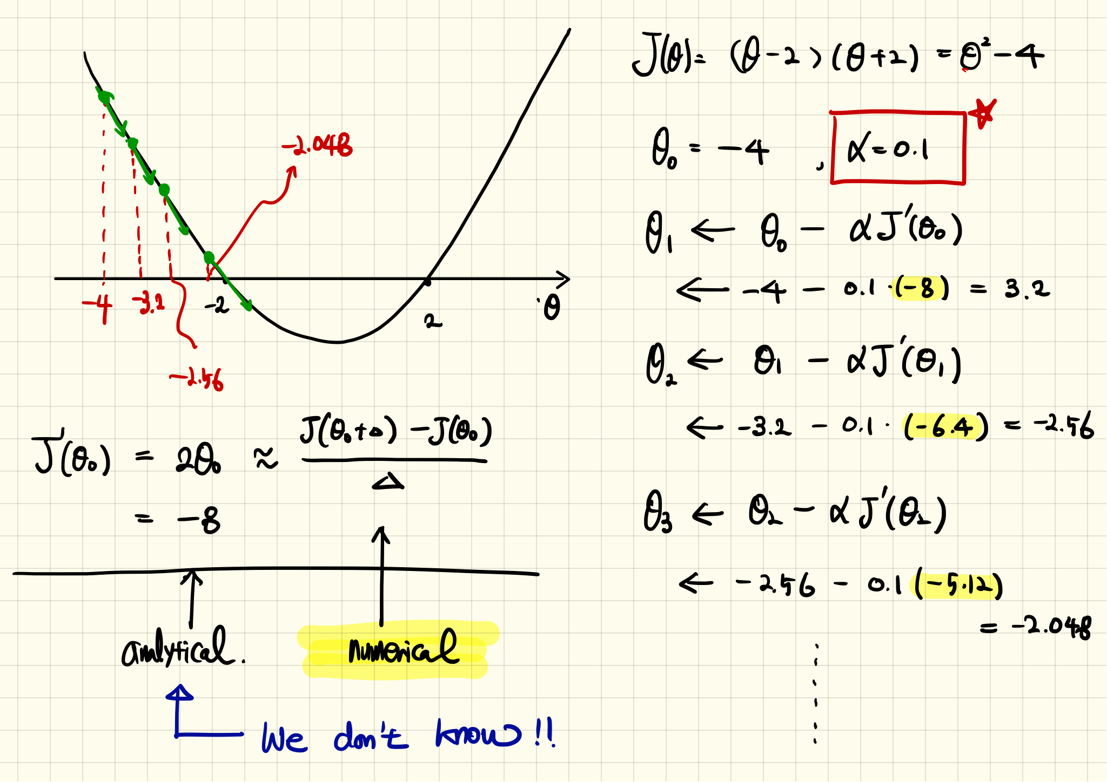
Example: Quadratic Function

Slide 5
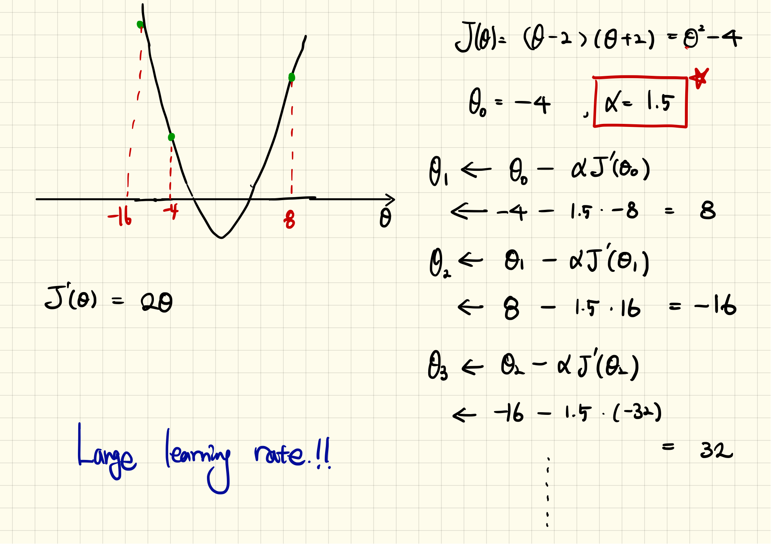
Example: Quadratic Function (Continue)

Slide 6
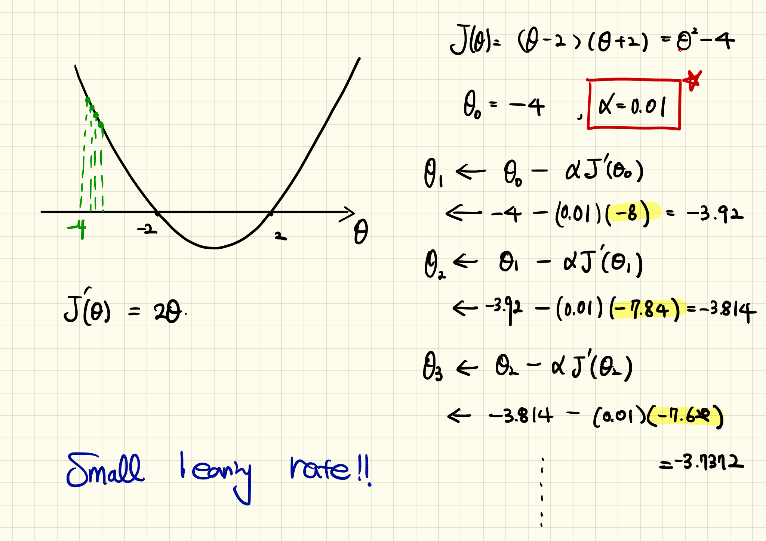
Example: Quadratic Function (Continue)

Slide 7
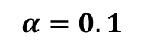
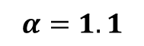
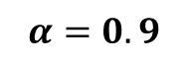
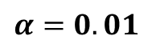
Example: Quadratic Function (Simulation)
10 iterations
$$α=0.1$$
$$α=0.01$$
$$α=1.1$$
$$α=0.9$$
See tutorials

Slide 8
https://ml-cheatsheet.readthedocs.io/en/latest/gradient_descent.html

Slide 9

Effect of Learning Rates

Slide 10
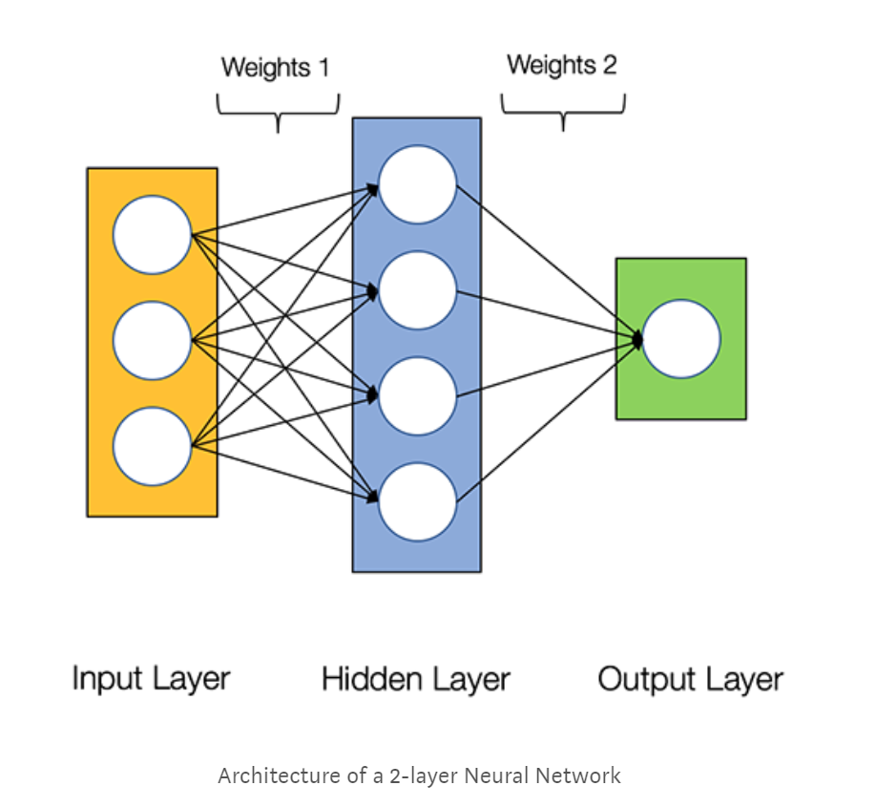
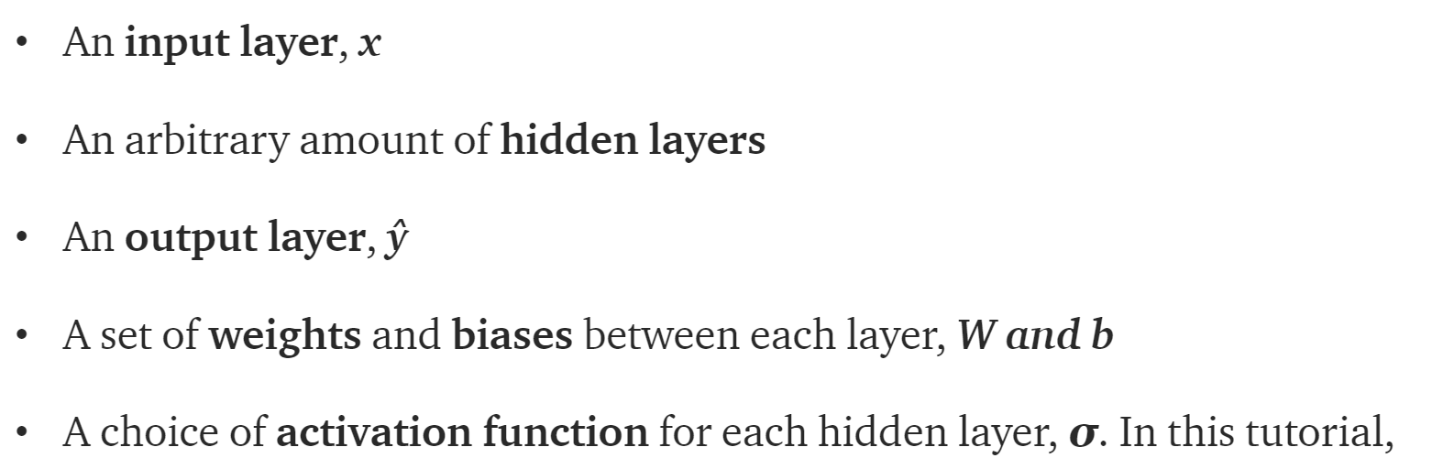
What’s a Neural Network

Slide 11
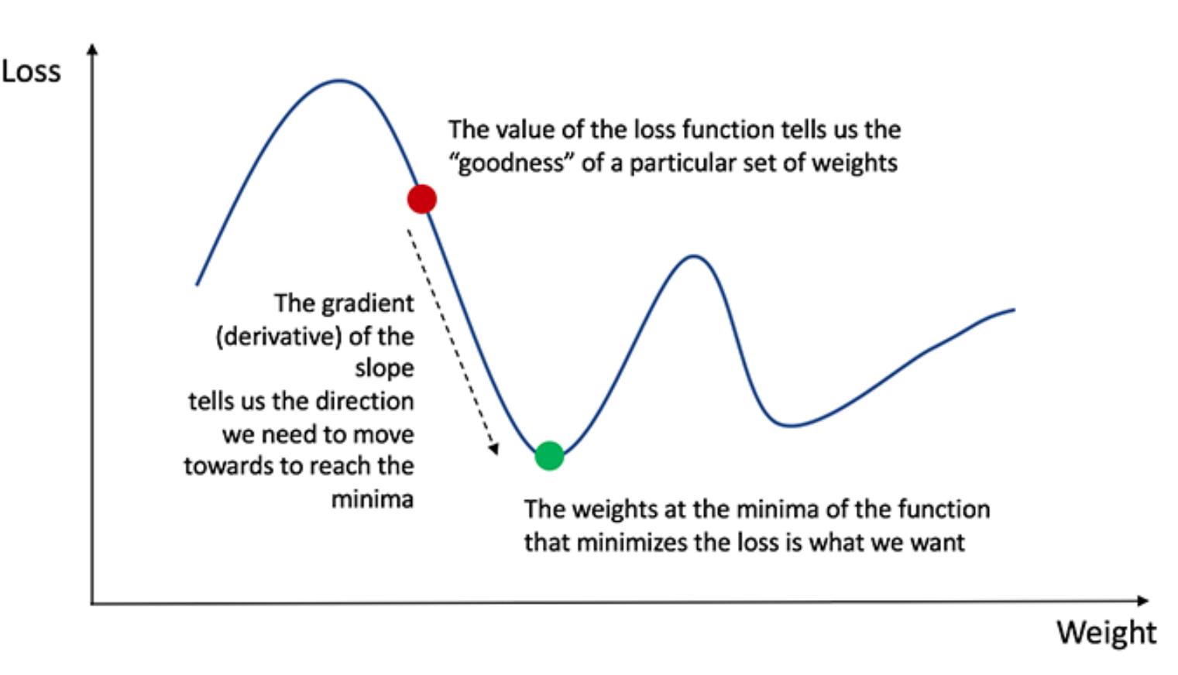
Training the Neural Network
Naturally, the right values for the weights and biases determines the strength of the predictions. The process of fine-tuning the weights and biases from the input data is known as training the Neural Network.
Our goal in training is to find the best set of weights and biases that minimizes the loss function.
Calculating the predicted output y, known as feedforward
Updating the weights and biases, known as backpropagation

Slide 12
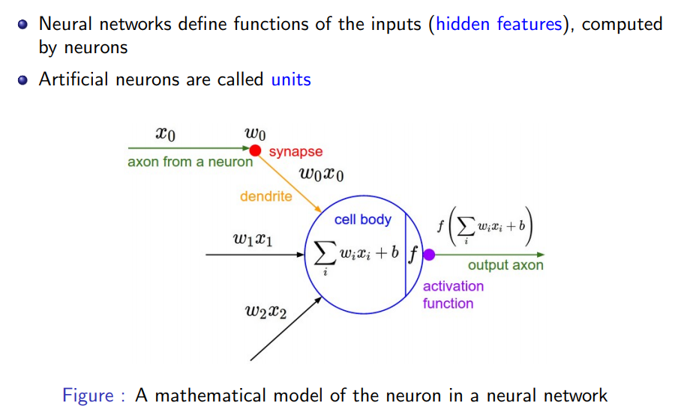
Mathematical Model of a Neuron

Slide 13
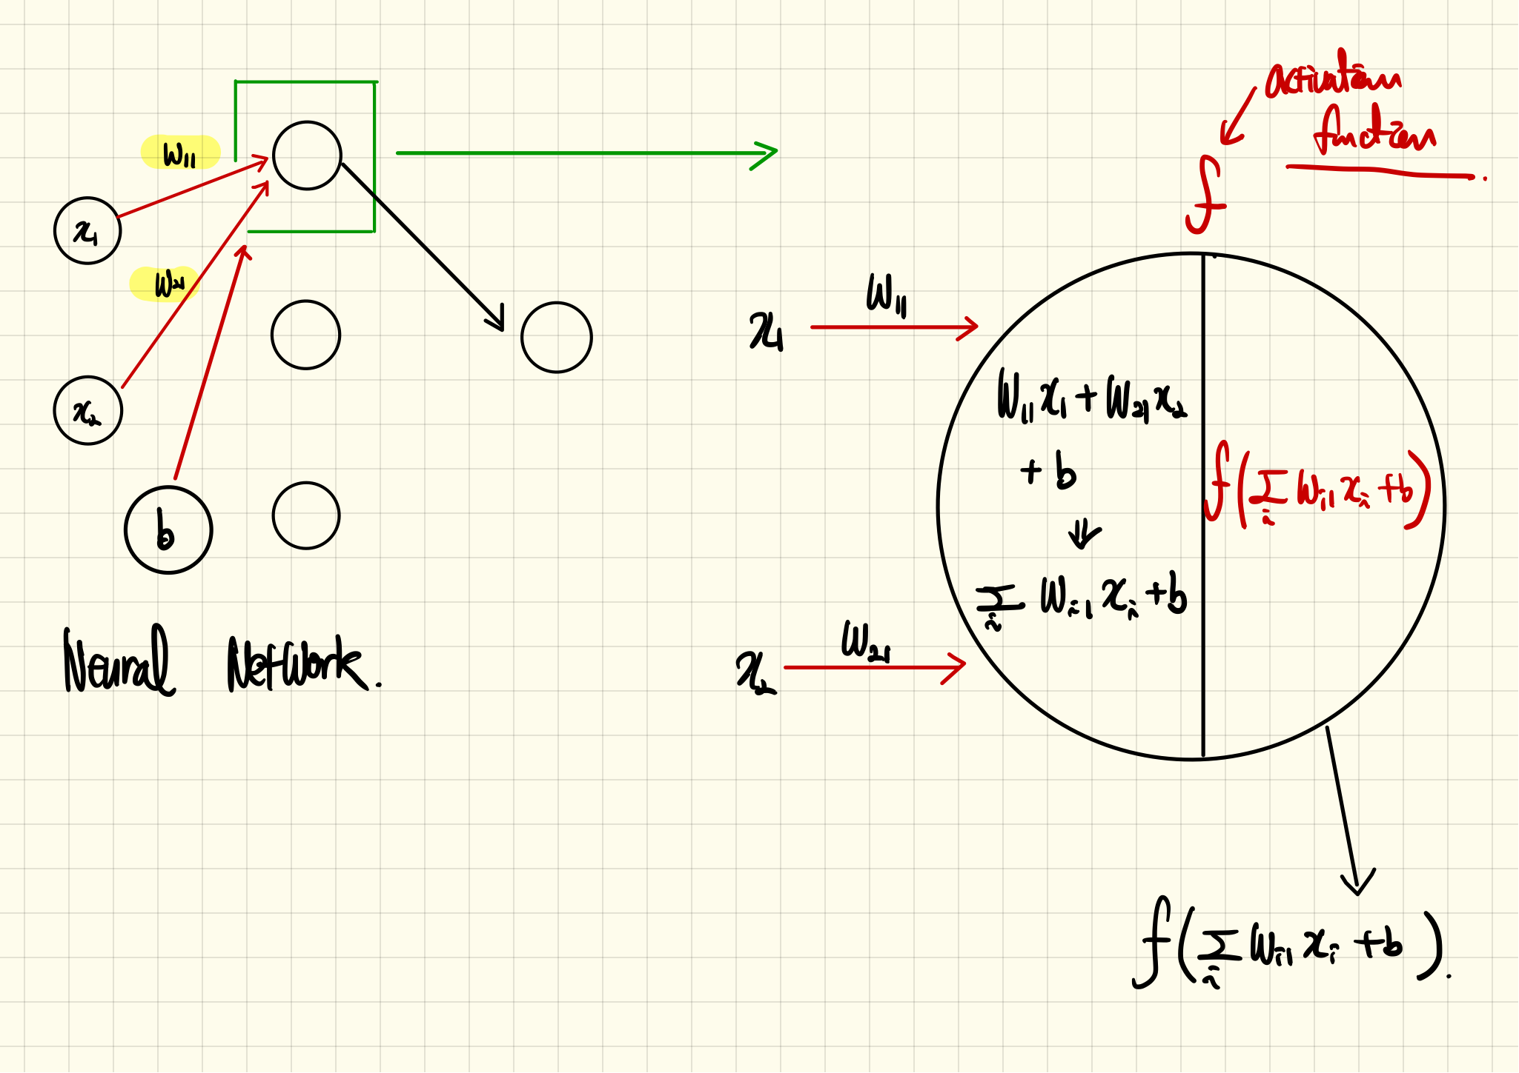
Mathematical Model of a Neuron (Continue)

Slide 14
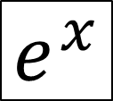
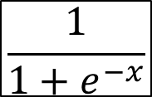
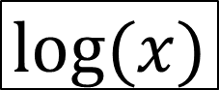
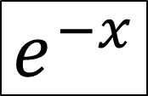
Some Functions
$$e^{x}$$
$$e^{−x}$$
$$\frac{1}{1+e^{−x}}$$
$$log⁡(x)$$

Slide 15
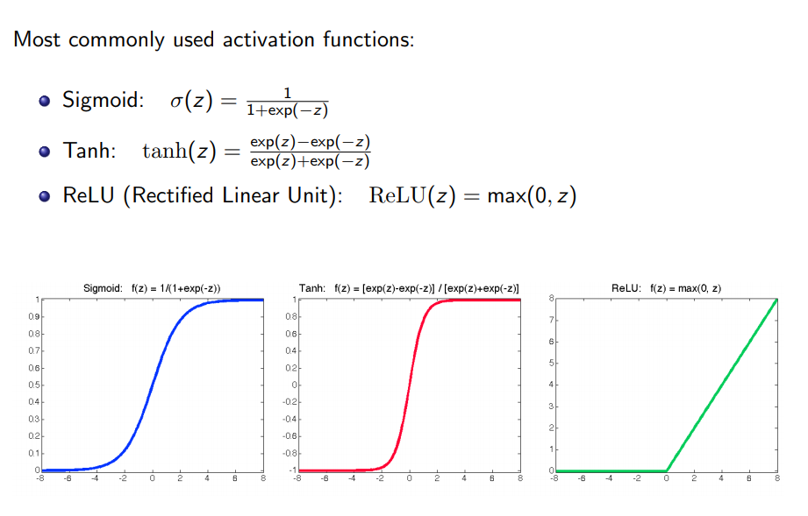
Activation Functions

Slide 16

Activation Functions and Their Derivatives
https://towardsdatascience.com/activation-functions-neural-networks-1cbd9f8d91d6

Slide 17
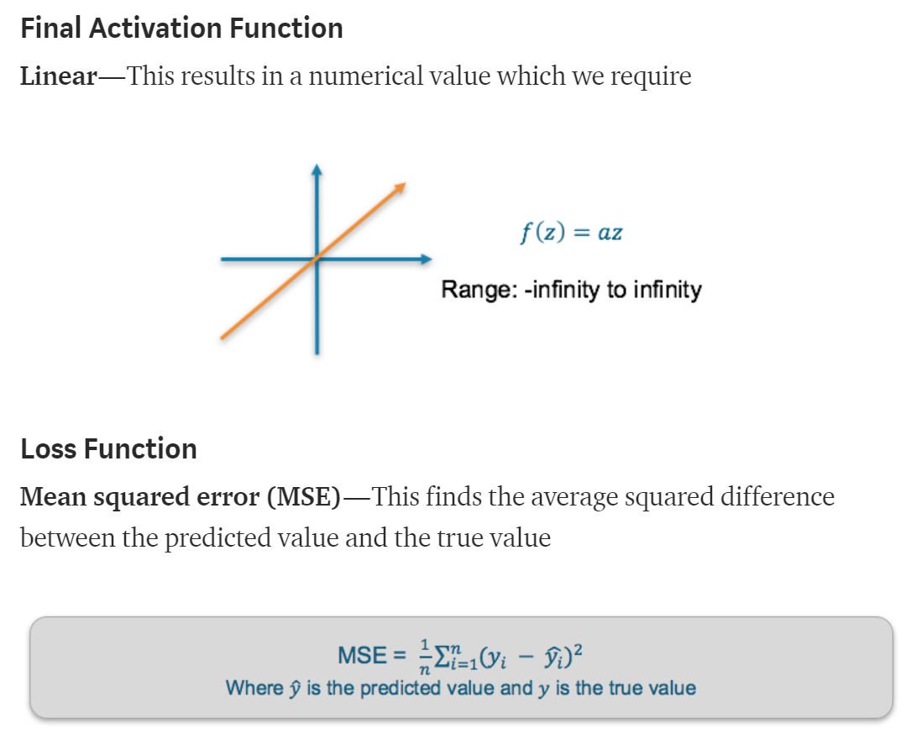
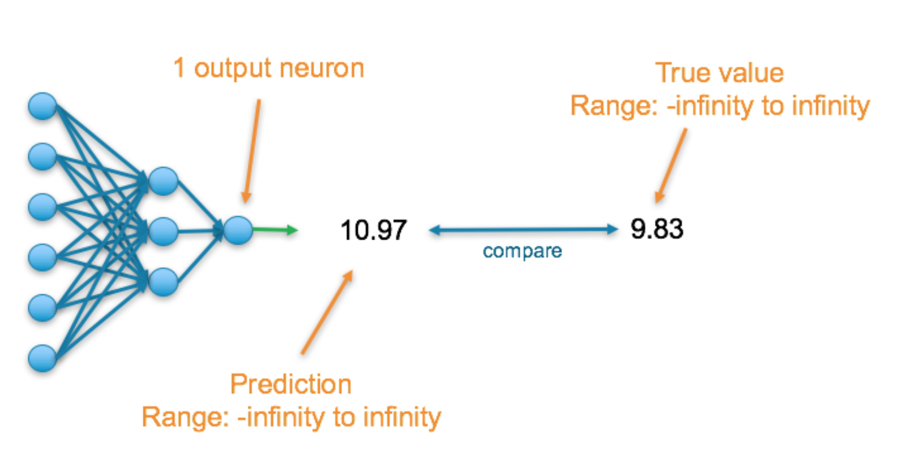
Loss Function
There are many available loss functions, and the nature of our problem should dictate our choice of loss function.
Regression

Slide 18
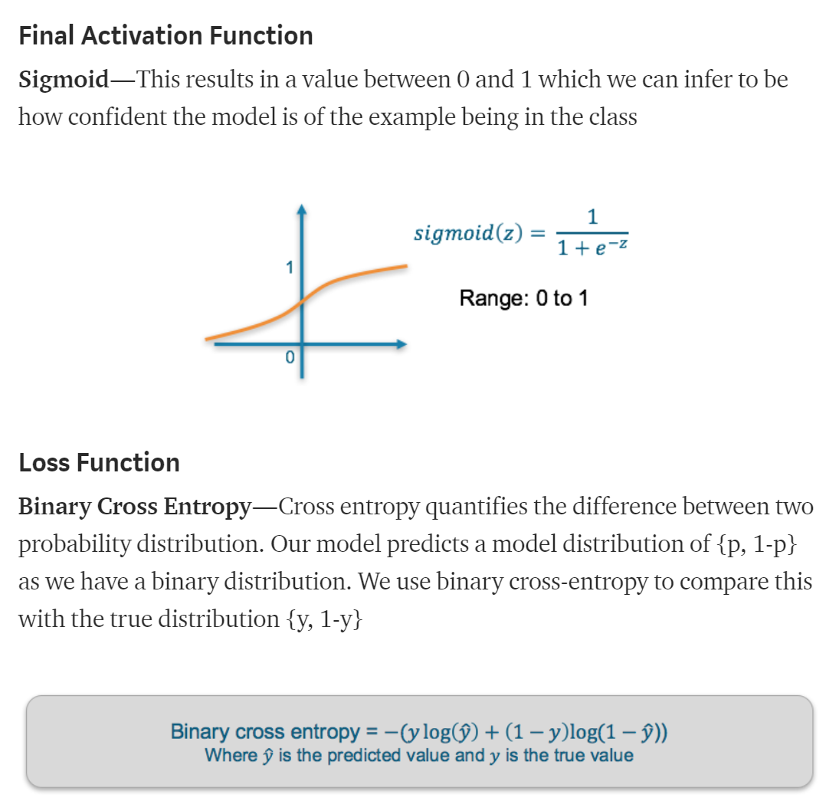
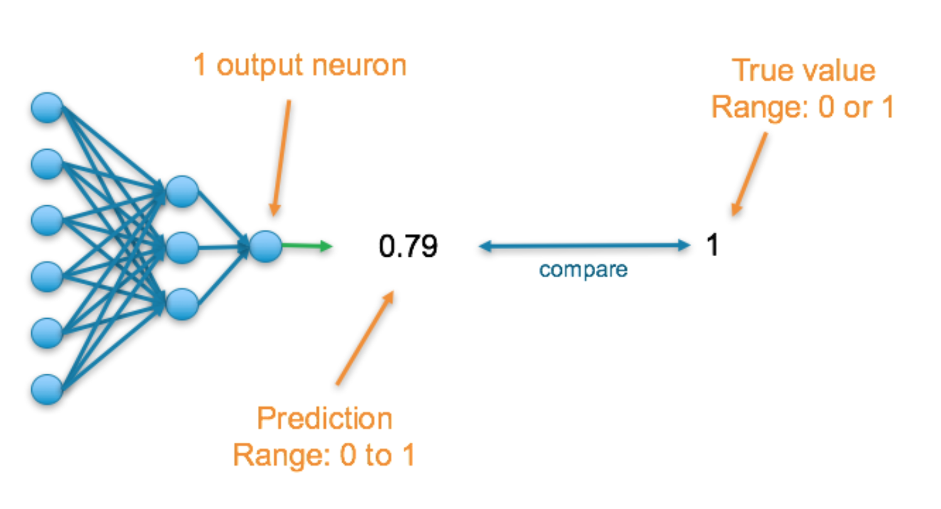
Loss Function (Continue)

Slide 19
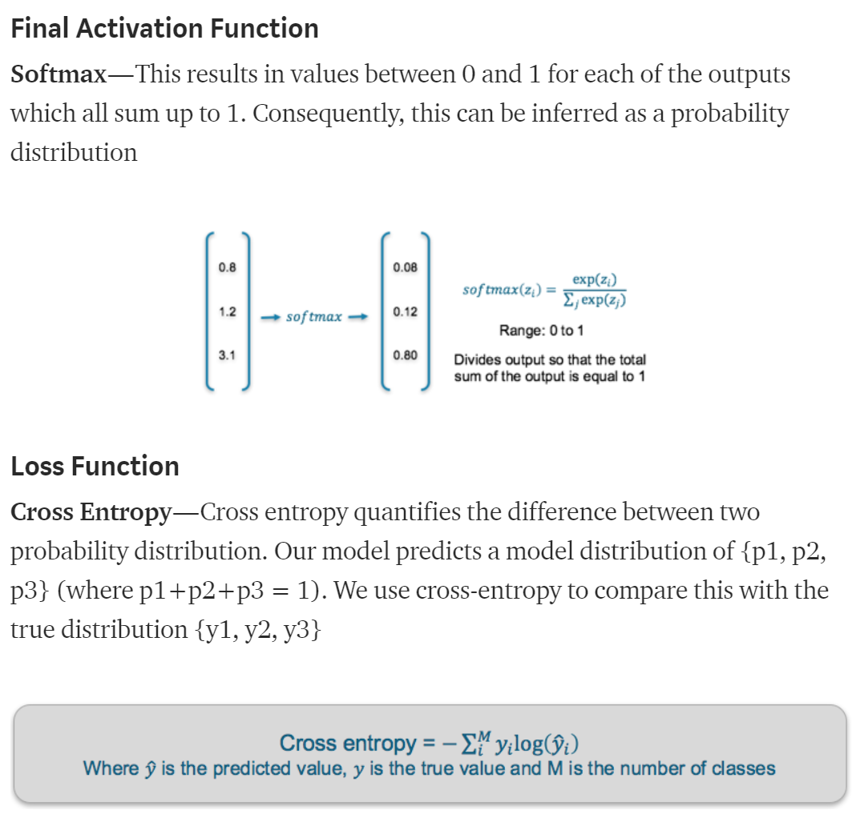
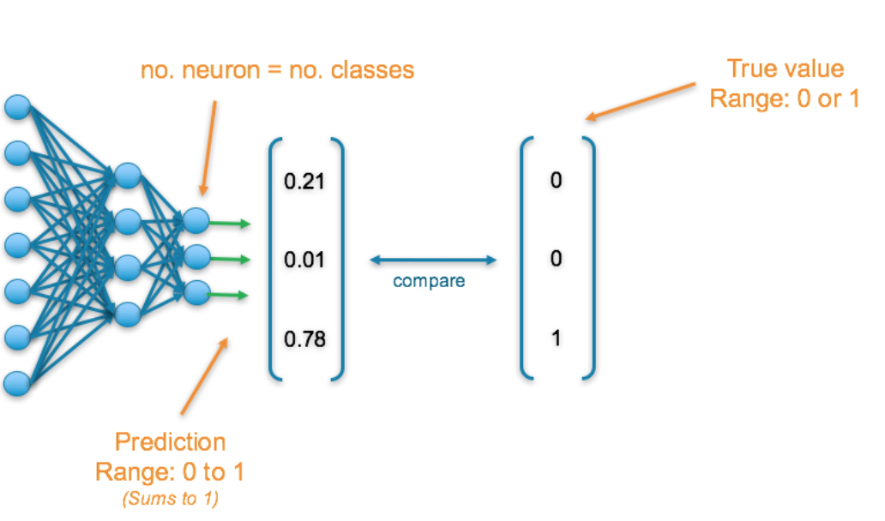
Loss Function (Continue)

Slide 20
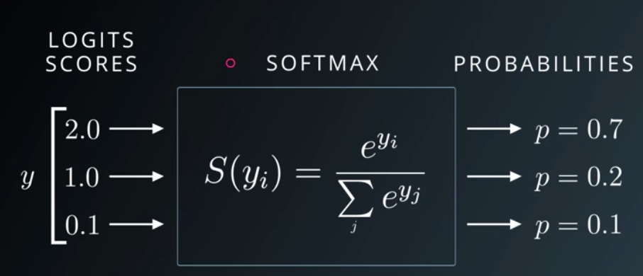
Softmax Function

Slide 21
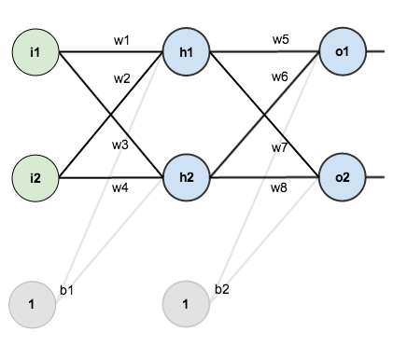
A Step-by-step Forward and Backward Propagation
One hidden layer (two hidden neurons)
Two output neuron
Two input neuron
Activation function: Logistic function
Two input → Two output

Slide 22
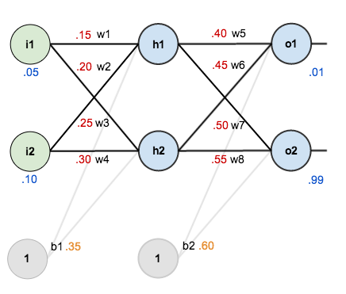
Initial Weights, Biases, and Training Inputs/Outputs

Slide 23
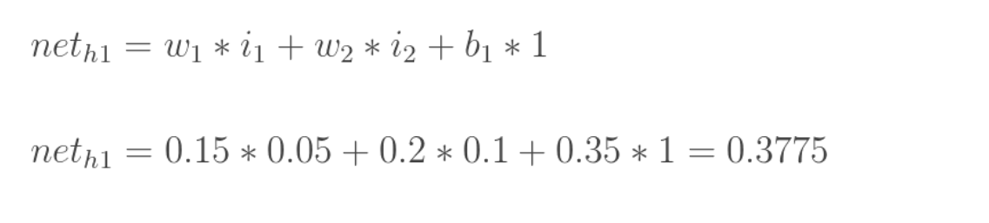
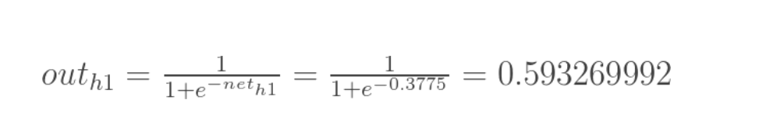
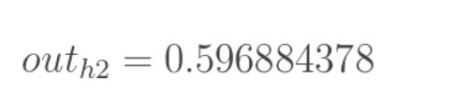
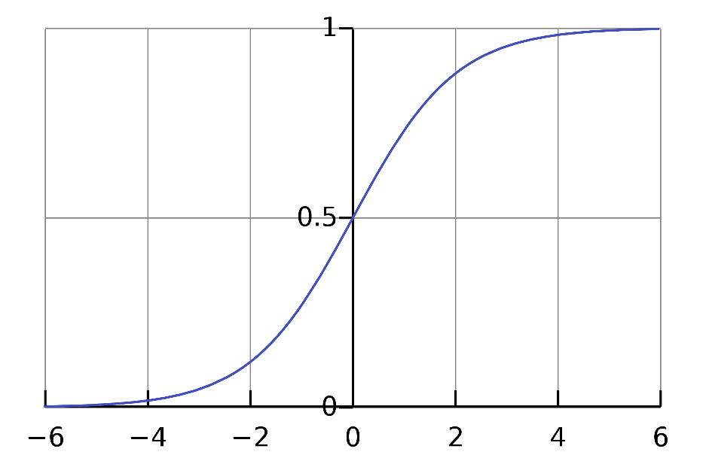
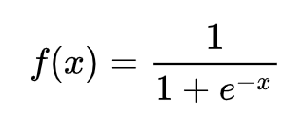
Forward Pass
Logistic function

Slide 24
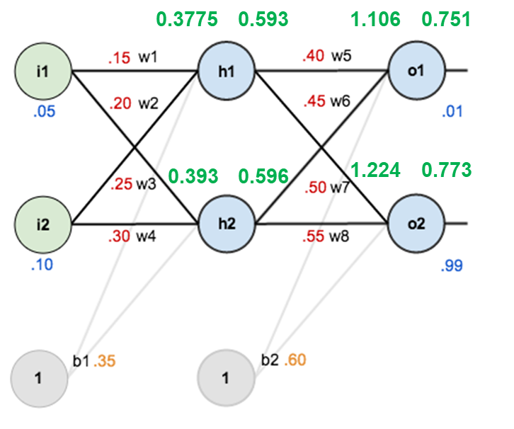
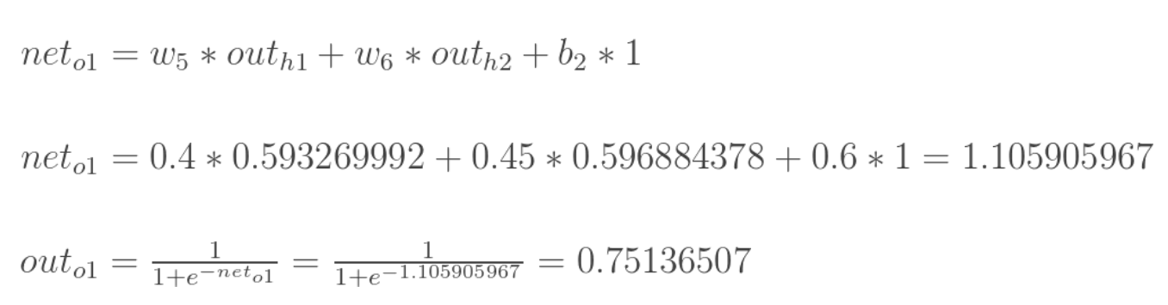
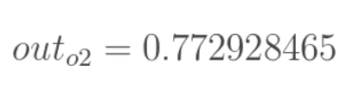
Forward Pass (Continue)

Slide 25
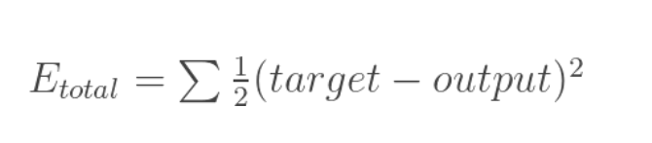
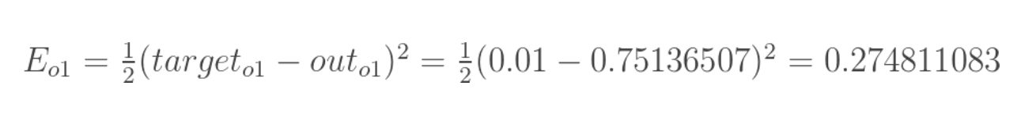
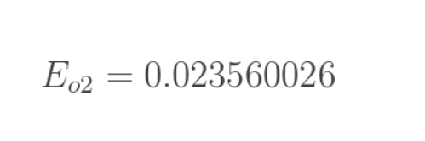
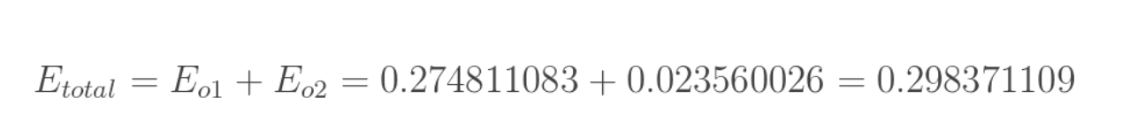
Calculating the Total Error
End of a forward pass

Slide 26
Backward Pass
Our goal with backpropagation is to update each of the weights in the network so that they cause the actual output to be closer the target output, thereby minimizing the error for each output neuron and the network as a whole. Our goal is to make the values in the red boxes 0.01 and 0.99, respectively by changing (updating) the weights.
0.3775
0.593
1.106
0.751
0.393
0.596
1.224
0.773

Slide 27
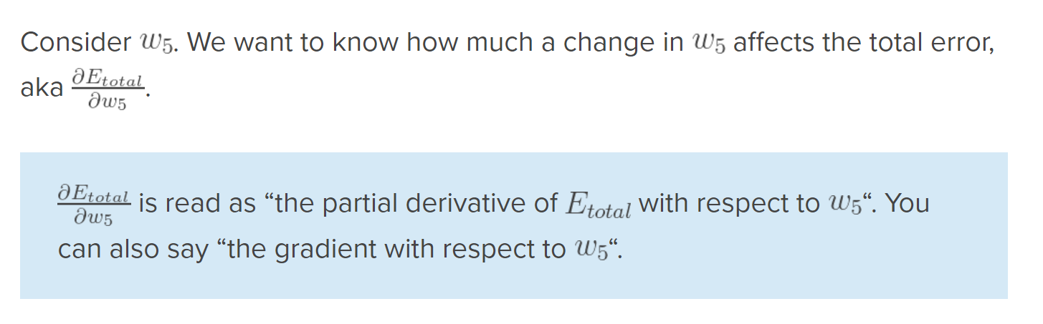
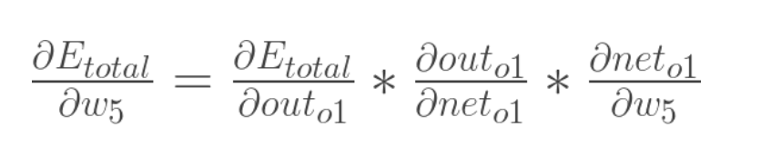
Output Layer
Chain rule

Slide 28
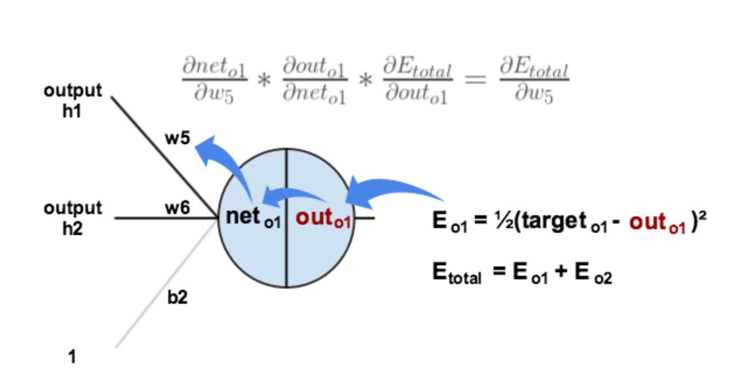
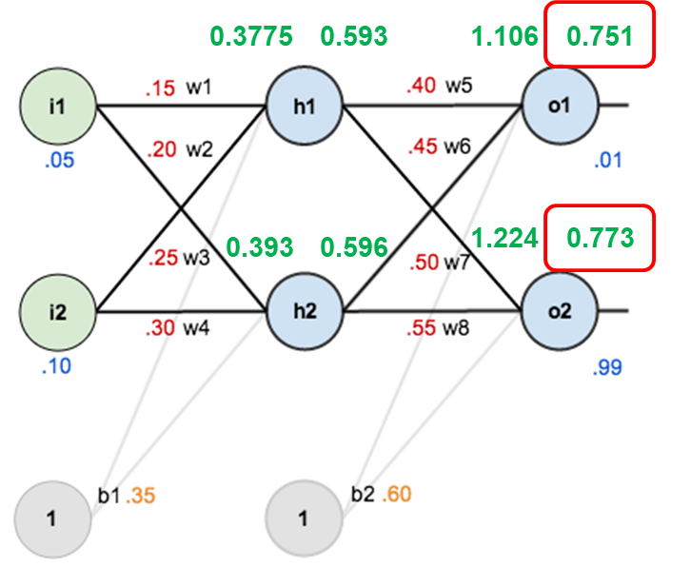
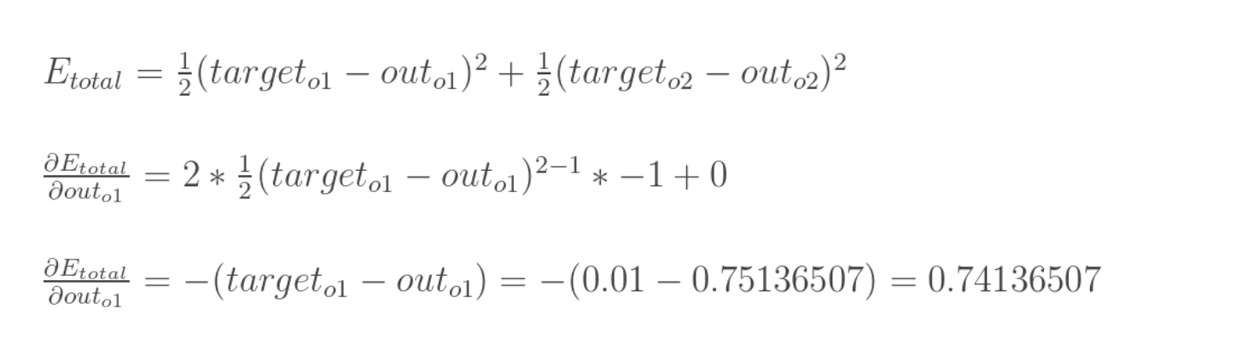
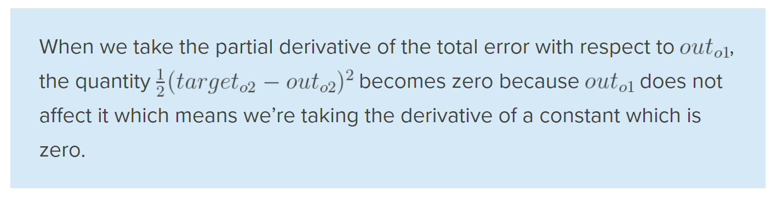
Output Layer (Continue)

Slide 29
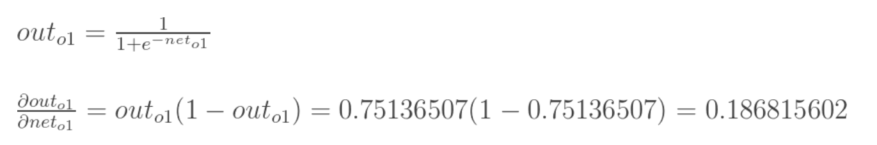
Output Layer (Continue)

Slide 30
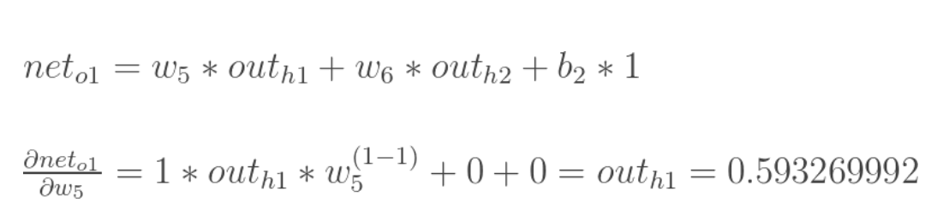
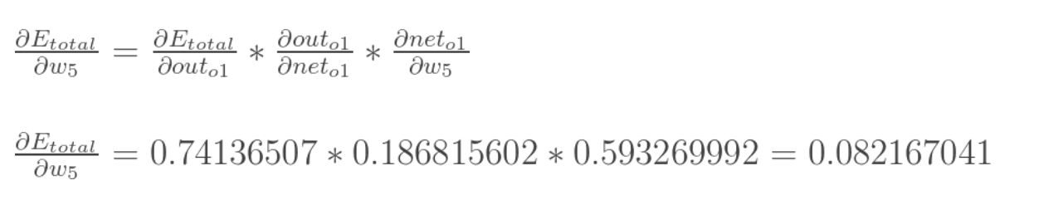
Output Layer (Continue)

Slide 31
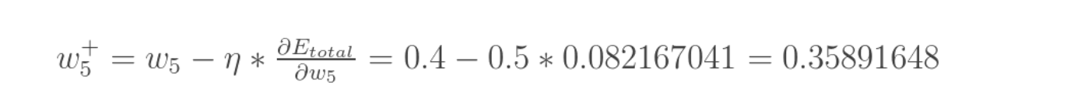
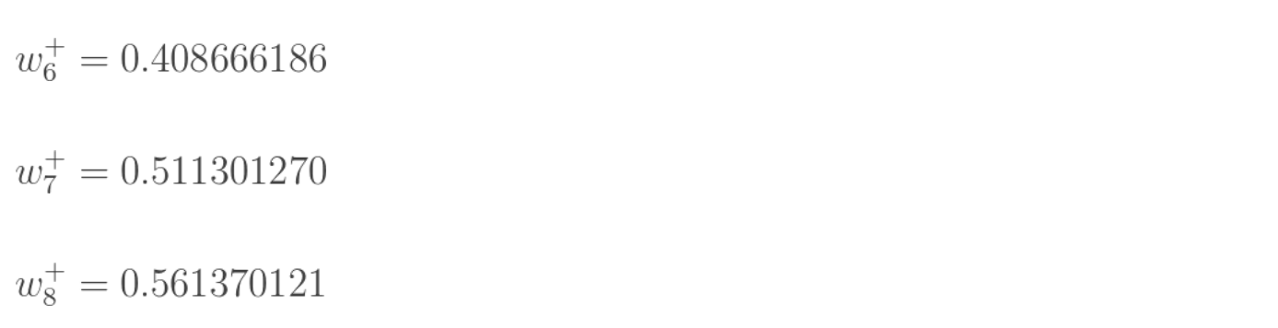

Output Layer (Continue)

Slide 32

Hidden Layer
W1, W2, W3, and W4 contribute both the E_{o1} and E_{o2}

Slide 33
What Did We Compute?
o2
o2
7
o2
o2
7
o2

Slide 34




Hidden Layer (Continue)
=

Slide 35



Hidden Layer (Continue)
=

Slide 36


Hidden Layer (Continue)

Slide 37

Hidden Layer (Continue)

Slide 38


Complete One Iteration (Forward and Back Propagation)

Slide 39


Another Example: A Step-by-step Forward and Backward Propagation
Two hidden layer
Three hidden neuron in each layer
Three output neuron
Three input neuron
Different activation functions
Three input → Three output
https://medium.com/@14prakash/back-propagation-is-very-simple-who-made-it-complicated-97b794c97e5c

Slide 40



Derivatives of Activation Functions

Slide 41

Initializing Network

Slide 42


Forward Propagation: Layer-1

Slide 43


Forward Propagation: Layer-2

Slide 44


Forward Propagation: Layer-3

Slide 45


Cross Entropy
https://stackoverflow.com/questions/36515202/why-is-the-cross-entropy-method-preferred-over-mean-squared-error-in-what-cases

Slide 46


Back Propagation: Layer-2 − Output

Slide 47

Back Propagation: Layer-2 − Output (Continue)

Slide 48

Back Propagation: Layer-2 − Output (Continue)

Slide 49

Back Propagation: Layer-2 − Output (Continue)

Slide 50


Back Propagation: Layer-2 − Output (Continue)

Slide 51


Back Propagation: Layer-1 − Layer 2

Slide 52


Back Propagation: Layer-1 − Layer 2 (Continue)

Slide 53


Back Propagation: Layer-1 − Layer 2 (Continue)

Slide 54


Back Propagation: Layer-1 − Layer 2 (Continue)

Slide 55




Gradient Descent Variants
Batch gradient descent: Batch Gradient Descent is when we sum up over all examples on each iteration when performing the updates to the parameters. Therefore, for each update, we have to sum over all examples:
Mini-batch gradient descent: Instead of going over all examples, Mini-batch Gradient Descent sums up over lower number of examples based on the batch size. Therefore, learning happens on each mini-batch of b examples:
Stochastic gradient descent: Instead of going through all examples, Stochastic Gradient Descent (SGD) performs the parameters update on each example (x^{i},y^{i}). Therefore, learning happens on every example:
https://towardsdatascience.com/gradient-descent-algorithm-and-its-variants-10f652806a3
https://medium.com/@montjoile/an-introduction-to-gradient-descent-algorithm-34cf3cee752b

Slide 56



Epoch vs Batch Size vs Iterations
https://towardsdatascience.com/epoch-vs-iterations-vs-batch-size-4dfb9c7ce9c9

Slide 57

Example: Neural Network Playground
http://playground.tensorflow.org/

Slide 58

Tutorial: Binary Classification (Gaussian)

Slide 59

Tutorial: Binary Classification (Circle)

